Slide 1
Disease Prediction System
Supervised By:
Dr. Debasish Bera

Slide 2

Indian Institute of Information Technology Kalyani
Submitted to:
Dr. Debasish Bera
Assistant Professor
IIIT KALYANI
Submitted by:
Rajnish Singh [CSE/19061/488]
Akash Singh [CSE/19007/434]
Harshit Sharma [CSE/19033/460]

Slide 3
OUTLINE
Slide No.
Introduction 4
Objective 5
Methodology 6-7
Work Done 8-15
Results 16-18
Future Work 19
References 20

Slide 4
INTRODUCTION
Technological advancement and cost reduction in disease prediction will greatly accelerate the medical field.
Prediction System helps to find a balance between developed and underdeveloped hospitals and experienced and inexperienced doctors.
Our Prediction System is based on a Symptoms Parameter and give the severeness of the symptons with the precautions measures.

Slide 5
OBJECTIVE
The work presents an intelligent and automatic disease prediction system using some probabilistic model, i.e. Decision Tree Algorithm, Kth Nearest Neighbour (KNN) and Artificial Neural Network (ANN). It uses the data set of large number of confirmed cases relationship between symptoms season of the patient make prediction more accurate and the system practically more useful as every disease diagnosis is other then symptoms is based on many others factors so it covers many of them.The diagnosis we done on the basis of comparing the symptoms and other parameters given by the user and comparing it with the confirmed cases data set giving the most probable disease.

Slide 6
METHODOLOGY
Extraction of data.
Cleaning the dataset.
Data Visulaization.
Training Model .[3]
Analysis of the manual data.
Trying Classifier to learn disease from the symptoms.
Finding the feature importance like severeness of Symptoms.
Getting the Precaution and Description of Diseases.
Integrating the GUI for better understanding and for better experience and ease to use.

Slide 7
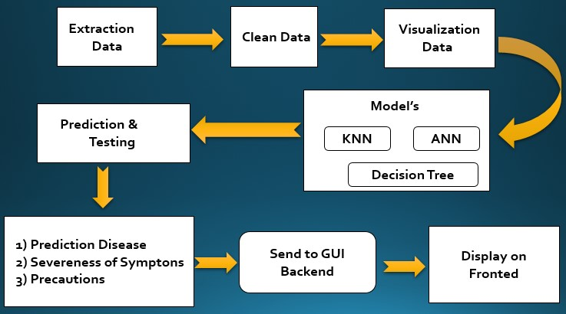
METHODOLOGY
This is the flow of our project

Slide 8
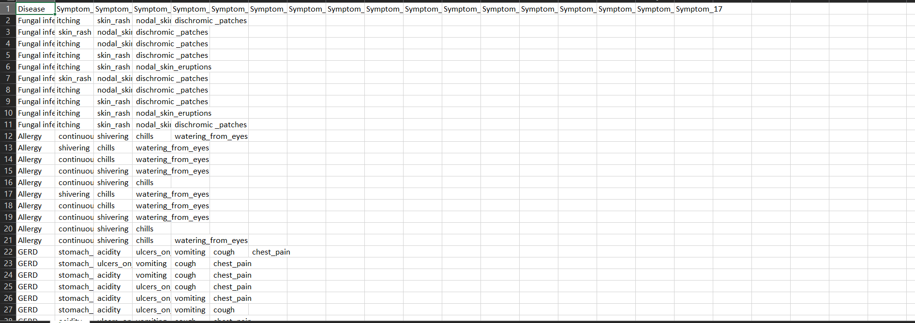
WORK DONE
Data Collection :
Source:https://www.kaggle.com/itachi9604/disease-symptom-description-dataset?select=dataset.csv

Slide 9
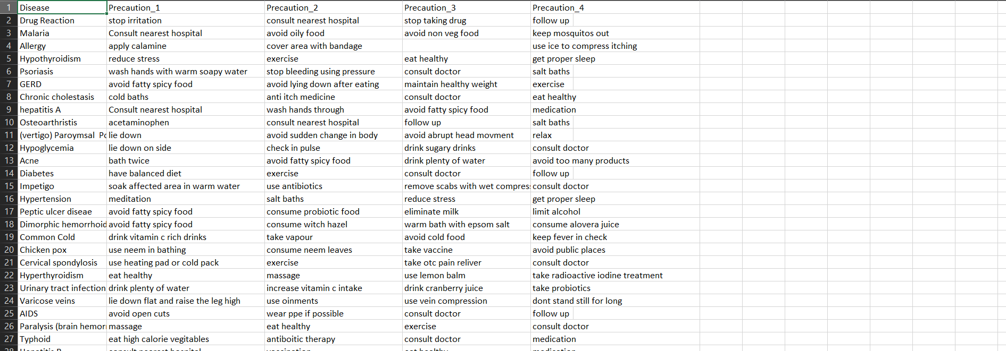
WORK DONE
Data Collection :
The list of precaution to be take in each Diseses.

Slide 10
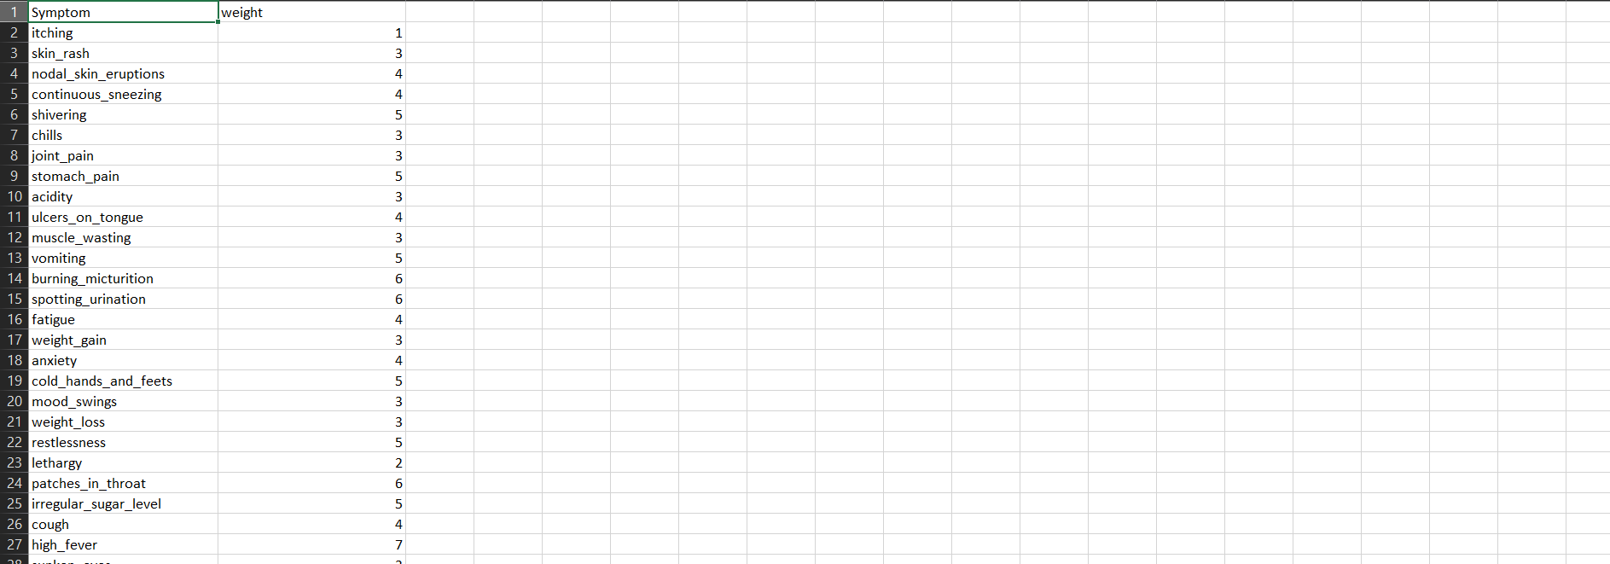
Work Done
Data Collection :
Symptoms Severeity as there weights .

Slide 11
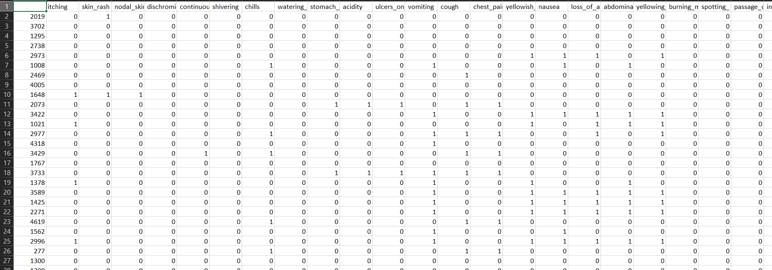
WORK DONE
Data Processing :
It summarizes how we did the data prepossessing by cleaning it and arranging in the way compatible
with the model for best prediction.

Slide 12
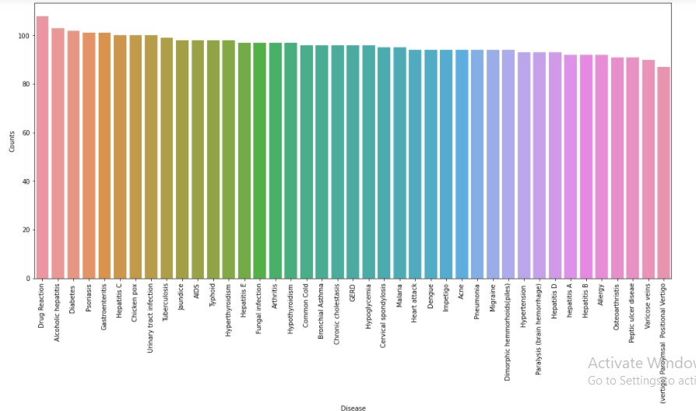
WORK DONE
Data Analysis :

Slide 13
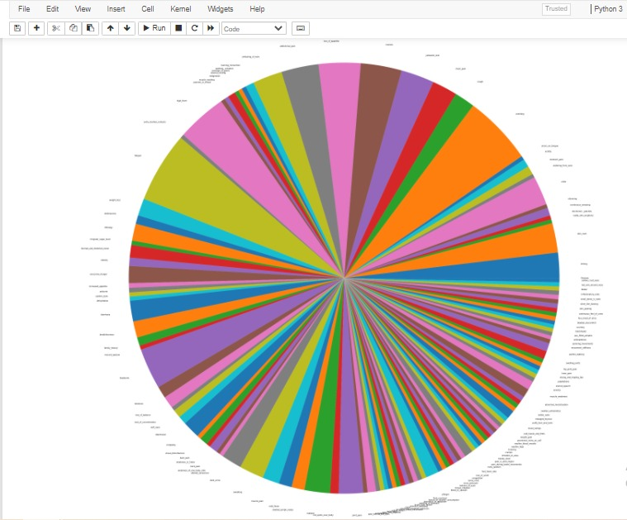
WORK DONE
Data Analysis :

Slide 14
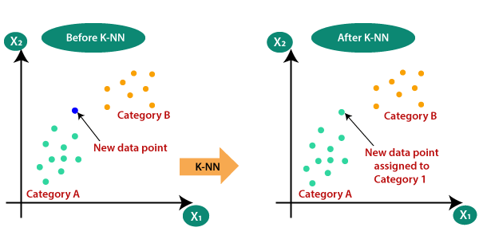
WORK DONE
Kth Nearest neighbour Algorithm :
Suppose there are two categories, i.e., Category A and Category B, and we have a new data point x1, so this data point will lie in which of these categories. To solve this type of problem, we need a K-NN algorithm. With the help of K-NN, we can easily identify the category or class of a particular dataset. Consider the below diagram:

Slide 15

WORK DONE
Decision Tree Model :
In general, Decision tree analysis is a predictive modelling tool that can be applied across many areas. Decision trees can be constructed by an algorithmic approach that can split the data set in different ways based on different conditions. Decisions trees are the most powerful algorithms that falls under the category of supervised algorithms.

Slide 16
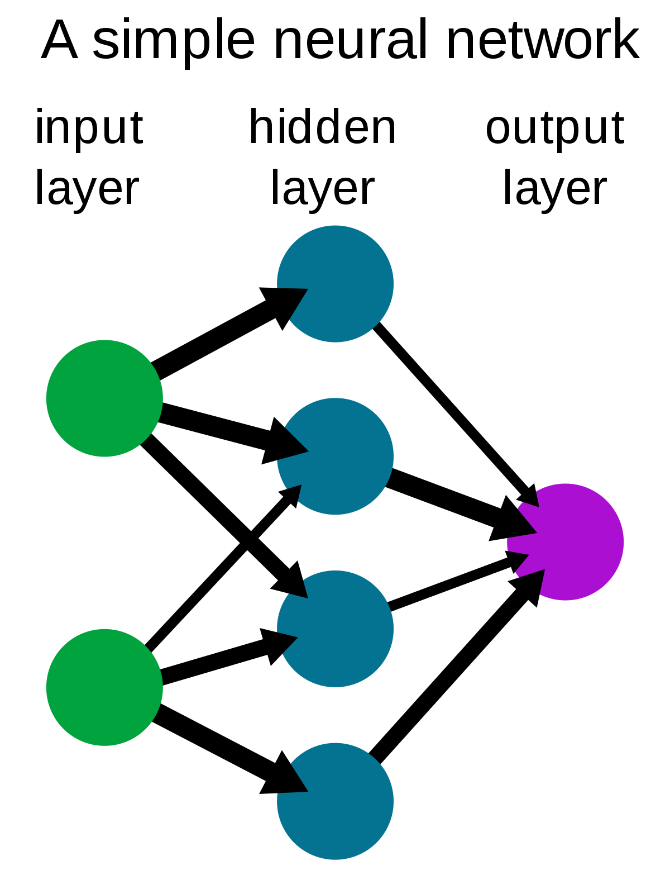
WORK DONE
Artificial Neural Network (ANN) :
An artificial neural network is an attempt to simulate the network of neurons that make up a human brain so that the computer will be able to learn things and make decisions in a humanlike manner. ANNs are created by programming regular computers to behave as though they are interconnected brain cells.

Slide 17
RESULT
Accuracy Achieved By Our Trained Model :
Artificial Neural Network:
No. of diseases as target classes: 41
No. of symptoms taken into account: 131
Model Trained: ANN
Accuracy achieved: 100%
F1 Score: 1

Slide 18
RESULT
Accuracy Achieved By Our Trained Model :
K NEAREST NEIGHBOUR ALGORITHM:
No. of diseases as target classes: 41
No. of symptoms taken into account: 131
Model Trained: KNN
Accuracy achieved: 99%
F1 Score: 0.99

Slide 19
RESULT
Accuracy Achieved By Our Trained Model :
DECISION TREE ALGORITHM:
No. of diseases as target classes: 41
No. of symptoms taken into account: 131
Model Trained: Decision Tree
Accuracy achieved: 99%
F1 Score: 0.99

Slide 20
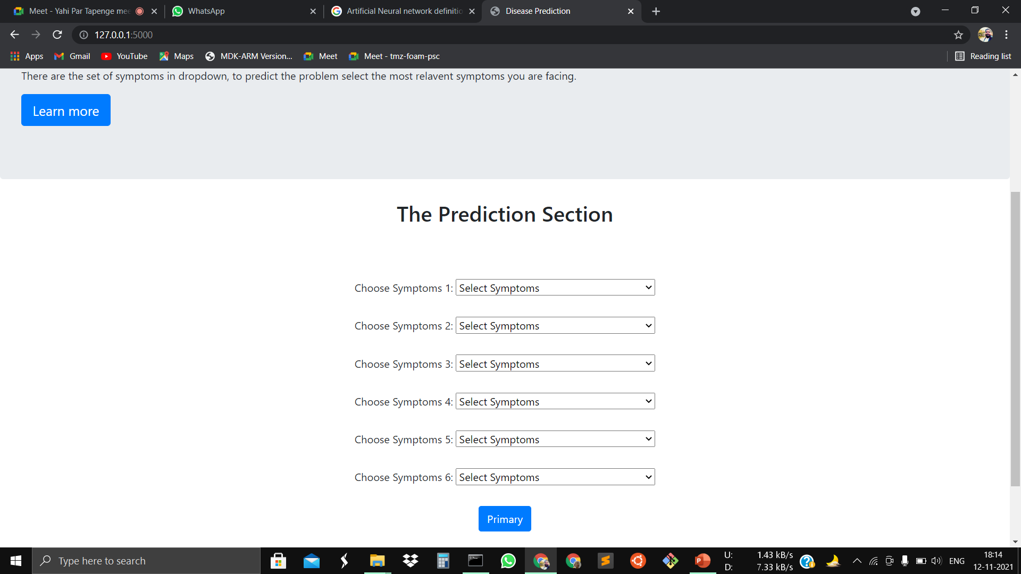
RESULT
Graphical User Interface :
1. Initialization: The symptoms under consideration and the trained model is loaded into the memory from the saved files which is stored at backend.
2. User Entry: The user enters the basic details and selects the symptoms experienced from
the drop-down lists of predefined symptoms.
3.Model Prediction: On clicking the Predict button the symptoms entered by the user are
passed to the trained model and the disease with the highest probability score is displayed as a
prediction of the model.Here prediction models are there
1.Prediction of disease by ANN model
2.Prediction of disease by Decision Tree model.
3. Prediction of disease by KNN model

Slide 21
FUTURE WORK
1. In future we plan to work on a larger dataset containing patient’s diagnosis reports, past medical history and test reports to better diagnose the disease.
2. We need to implement Epidemics also need to be taken into account while predicting the possible disease from patient’s symptoms.
3. Apart from ANN, KNN and Decision Tree we will try to Implement other models to check Which one giving the Highest Accuracy among all.

Slide 22
REFERENCES
[1] Dataset was taken from:Kaggle Database
[2] S.Agatonovic-Kustrin and R.Beresford Basic. Concepts of artificial neural network (ANN)
modeling and its application in pharmaceutical research
[3] Dhiraj Dahiwade, Prof. Gajanan Patle, Prof. Ektaa Meshram . Designing Disease Prediction
Model Using Machine Learning Approach
[4] A.DAVIS, D., V.CHAWLA, N.,CHRISTAKIS and BARBASI. PREDICTING INDIVIDUAL
DISEASE RISK BASED ON MEDICAL HISTORY
[5] Bojan Cestnik. Estimating probabilities: A crucial task in machine learning.

Slide 23


